Slide 1
Preliminary Volumes
 | BulkVolume [*10E6m^3] | Net Volume [*10E6m3] | STOIIP [*10E6Barrels] | GIIP [*10E9ft^3]
Zones
MGS | 253.07 | 227.76 | 62.68 | 535
ratty sand | 112.40 | 33.72 | 8.41 | 43
shale | 42.93 | 0.00 | 0.00 | 0.00
Good sand | 18.92 | 17.03 | 10 | 37.22
ratty sand | 1.76 | 0.88 | 0.44 | 1.20
rest | 0.00 | 0.00 | 0.00 | 0.00

Slide 2
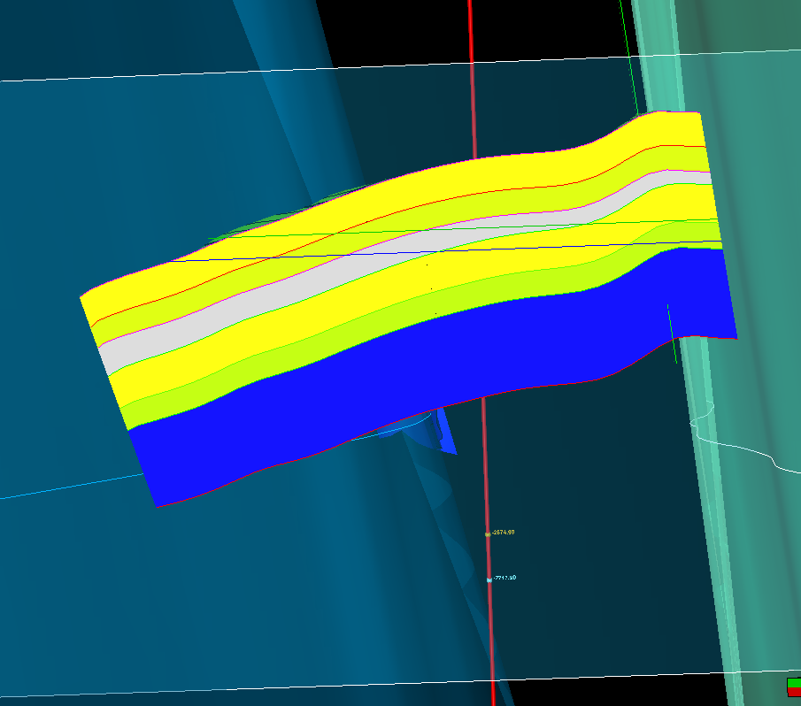
Cross section
Good MGS
Ratty Sand
Shale
Good OS sand
Ratty OS sand
Water bearing sand
GOC
OWC

